Slide 1

NeuroFleetX - AI-Driven Urban Mobility Optimization
Objective: Apply AI to improve the urban mobility system by optimizing traffic flow, reducing congestion, and improving transportation efficiency through intelligent data analysis and predictive modeling.
Technologies: React (frontend), Spring Boot (backend), MongoDB (database), Tailwind CSS (styling).
Methodology: Agile development framework with two distinct sprints for iterative development and continuous feedback integration.

Slide 2



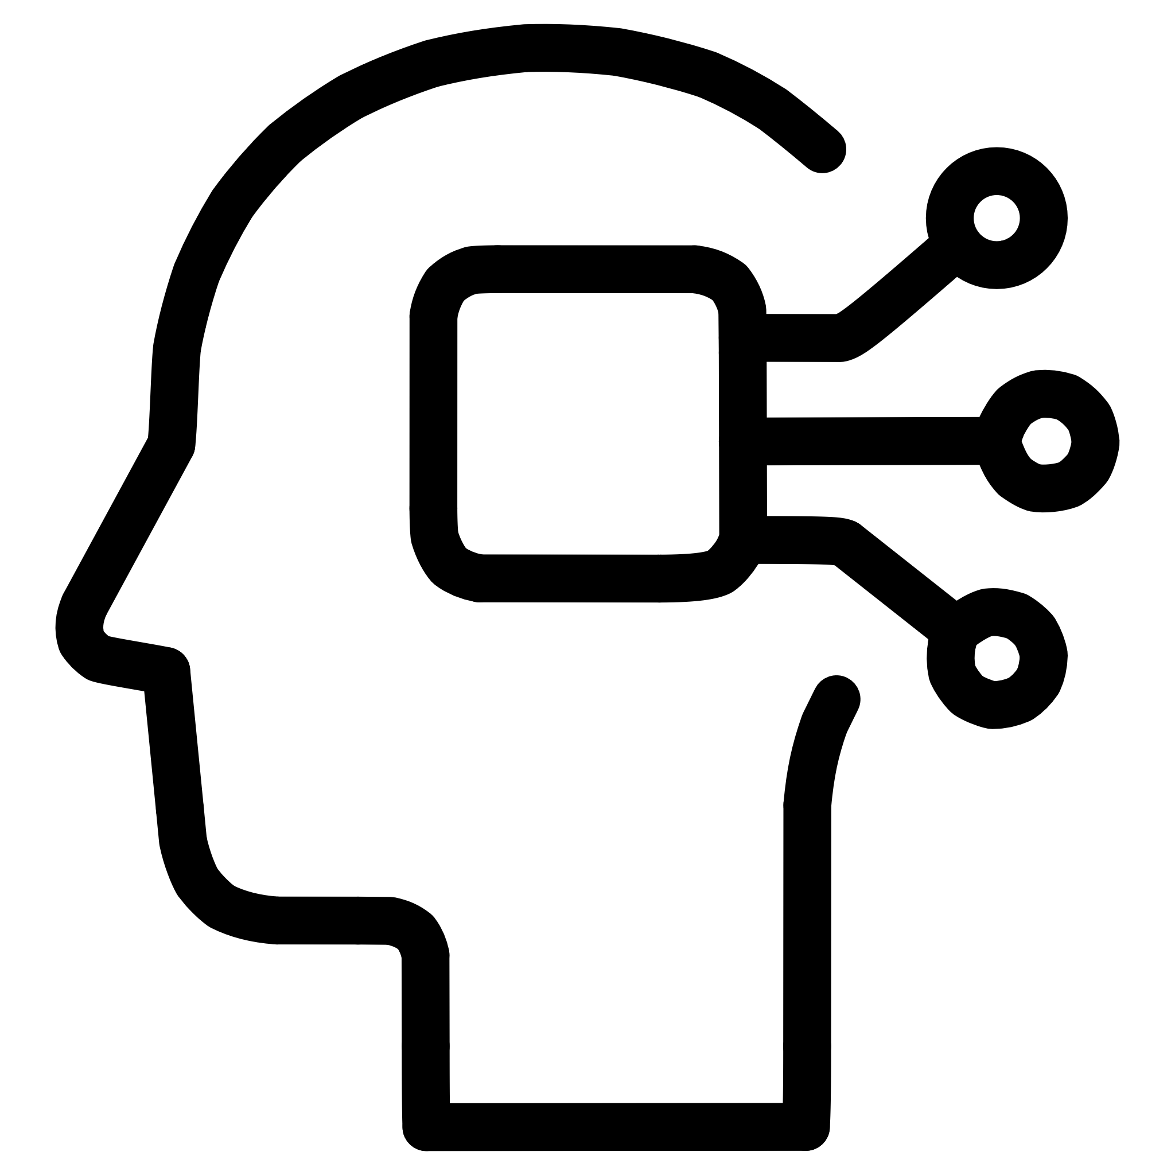

NeuroFleetX - AI-Driven Urban Mobility Optimization
The NeuroFleetX project leverages cutting-edge Artificial Intelligence to revolutionize urban transportation systems. Through intelligent data analysis and predictive modeling, it aims to optimize traffic flow, significantly reduce congestion, and enhance overall transportation efficiency.
Project Objective
Key Technologies
Apply AI to improve urban mobility by optimizing traffic flow, reducing congestion, and improving transportation efficiency through intelligent data analysis and predictive modeling.
Utilizing a robust tech stack including React for dynamic frontend interfaces, Spring Boot for powerful backend APIs, MongoDB for flexible NoSQL database management, and Tailwind CSS for responsive styling.
Methodology
Expected Outcomes
Implemented an Agile development framework with two distinct sprints, ensuring iterative development, continuous feedback integration, and efficient delivery of project milestones.
Anticipate a significant improvement in urban mobility, leading to reduced travel times, decreased fuel consumption, lower emissions, and a more sustainable and efficient transportation network.

Slide 3
NeuroFleetX: AI-Driven Urban Mobility Optimization
This card provides a detailed overview of the NeuroFleetX project, an AI-driven solution developed during my internship to enhance urban mobility. It outlines the project's core components, key objectives, and the technical approach utilized to achieve a smarter, more sustainable transportation network.
Project Title
Technologies Used
NeuroFleetX - AI-Driven Urban Mobility Optimization
React: Core JavaScript library for building the dynamic frontend user interfaces.
Objective
Spring Boot: Java-based framework for developing the backend RESTful APIs and services.
The main aim of the NeuroFleetX project is to apply AI to improve the urban mobility system. It aims at optimizing traffic flow, reducing congestion, and improving transportation efficiency by enabling intelligent data analysis and predictive modeling. In other words, NeuroFleetX develops smarter, more sustainable, adaptive urban transport networks through the integration of AI-driven insights for dynamic responses to real-time conditions.
MongoDB: NoSQL database for efficient storage and querying of application data.
Tailwind CSS: Utility-first CSS framework for responsive and modern styling.
Methodology
The project adopted an Agile development framework, structured into two distinct sprints. This approach allowed for iterative development, continuous integration of feedback, and adaptive planning, ensuring alignment with project goals and stakeholder expectations.

Slide 4
NeuroFleetX - AI-Driven Urban Mobility Optimization: Sprint 1 Execution
Sprint 1 focused on laying the foundational data processing and initial visualization for the NeuroFleetX project. This period was crucial for developing the core functionalities to optimize urban mobility by applying AI, reducing congestion, and improving transportation efficiency through intelligent data analysis and predictive modeling.
Core AI Data Analysis Logic
Backend APIs & System Integration
Implemented sophisticated AI algorithms for analyzing extensive urban mobility datasets, focusing on traffic flow patterns, congestion hotspots, and predictive modeling for optimization. This involved processing vast amounts of data to derive actionable insights for NeuroFleetX.
Developed robust RESTful APIs using Spring Boot to facilitate seamless data exchange between AI models, the React frontend, and various urban data sources. These APIs ensured efficient communication and integration across the NeuroFleetX ecosystem.
AI Model Output & Validation
Initial Urban Mobility Dashboard
Generated initial outputs from AI models, rigorously validating their predictions against real-world urban mobility data. This step was critical for ensuring the accuracy and reliability of the AI-driven optimizations that are central to the NeuroFleetX project.
Designed and built preliminary dashboards to visualize key urban mobility metrics and AI-driven insights. These initial dashboards provided a clear overview of traffic efficiency, predicted congestion, and potential optimization areas within the NeuroFleetX system.

Slide 5

NeuroFleetX - AI-Driven Urban Mobility Optimization
NeuroFleetX aims to apply advanced AI techniques to revolutionize urban mobility systems. Our objective is to optimize traffic flow, significantly reduce congestion, and ultimately improve transportation efficiency through intelligent data analysis and predictive modeling.
Core Technology Stack
Agile Development Framework
Utilized a robust technology stack including React for dynamic frontend interfaces, Spring Boot for scalable backend APIs, MongoDB for flexible NoSQL data storage, and Tailwind CSS for responsive and modern styling.
Adopted an Agile development framework featuring two distinct sprints, ensuring iterative development, continuous feedback integration, and rapid adaptation to evolving project requirements.
Traffic Flow Optimization
Predictive Modeling for Efficiency
Implemented advanced AI algorithms for real-time traffic flow optimization and congestion reduction, analyzing urban data to suggest dynamic routing and resource allocation strategies.
Developed sophisticated predictive models to forecast demand, optimize routing, and enhance overall transportation efficiency, laying the groundwork for smart urban planning.

Slide 6
NeuroFleetX: Week-wise Project Updates
This timeline outlines the key activities and achievements across the 8-week development cycle for NeuroFleetX, demonstrating our structured approach to AI-driven urban mobility optimization.
Week 1-2: Project Initiation & Research
1
Domain understanding, technology stack selection, task breakdown, and development environment setup for NeuroFleetX urban mobility optimization.
2
Week 3-4: Sprint 1 Execution
Core AI data analysis logic implementation, initial urban mobility dashboards, backend APIs development using Spring Boot, and AI model output validation.
Week 5-6: Sprint 2 & Feature Enhancements
3
Advanced analytics integration for traffic optimization, UI/UX refinement for dashboards, collaborative testing and debugging, and performance optimization for real-time data processing.
4
Week 7-8: Finalization & Documentation
Comprehensive project documentation, final presentation and demo preparation showcasing NeuroFleetX capabilities, and feedback integration for delivery excellence.

Slide 7








NeuroFleetX: Milestone Completion Summary
Milestone 1: Project Planning & Setup
Milestone 2: Sprint 1 Deliverables
Successfully completed on time, establishing a solid foundation with clear objectives for urban mobility optimization, defined requirements for AI implementation, and a ready development environment with React, Spring Boot, MongoDB, and Tailwind CSS.
Achieved all defined user stories and initial functionalities, including core AI data analysis logic for traffic pattern recognition and preliminary dashboards for urban mobility metrics visualization.
Milestone 3: Sprint 2 & Advanced Features
Milestone 4: Final Presentation & Documentation
Successfully delivered enhanced features including advanced analytics for congestion prediction, significant UI/UX improvements for dashboard interactivity, and performance optimization for real-time data processing.
Project successfully presented to mentors and stakeholders, accompanied by comprehensive technical documentation, deployment guides, and a compelling demonstration of NeuroFleetX's AI-driven urban mobility optimization capabilities.

Slide 8












NeuroFleetX - AI-Driven Urban Mobility Optimization
NeuroFleetX is a groundbreaking project focused on applying AI to revolutionize urban mobility, optimizing traffic flow, reducing congestion, and improving overall transportation efficiency through intelligent data analysis and predictive modeling.
AI-Driven Optimization
Traffic Flow Management
Leveraging artificial intelligence to intelligently analyze data and predict optimal traffic patterns.
Optimizing traffic movement to reduce congestion and enhance the smoothness of urban transportation.
Enhanced Urban Mobility
React Frontend Interface
Aiming to create a more efficient, less congested, and sustainable urban transportation system.
Developed dynamic and intuitive user interfaces using the React framework for seamless interaction.
Agile Development
Spring Boot & MongoDB
Structured around an Agile framework with two sprints, ensuring iterative development and continuous feedback.
Powered by Spring Boot backend APIs and a flexible MongoDB NoSQL database for robust data handling.

Slide 9
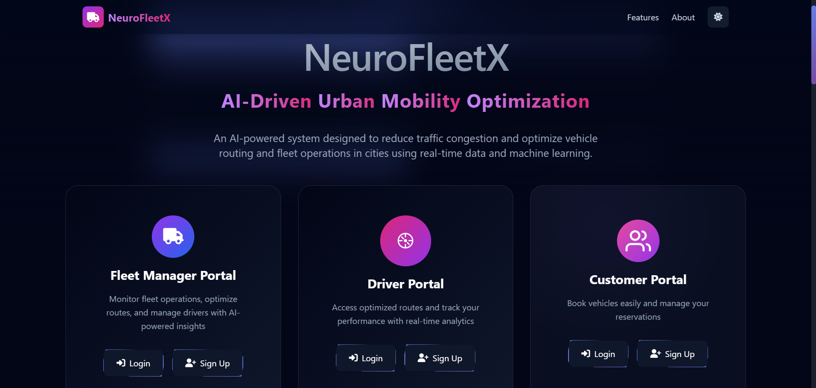
Project Output & Results - Screenshot 1

Slide 10
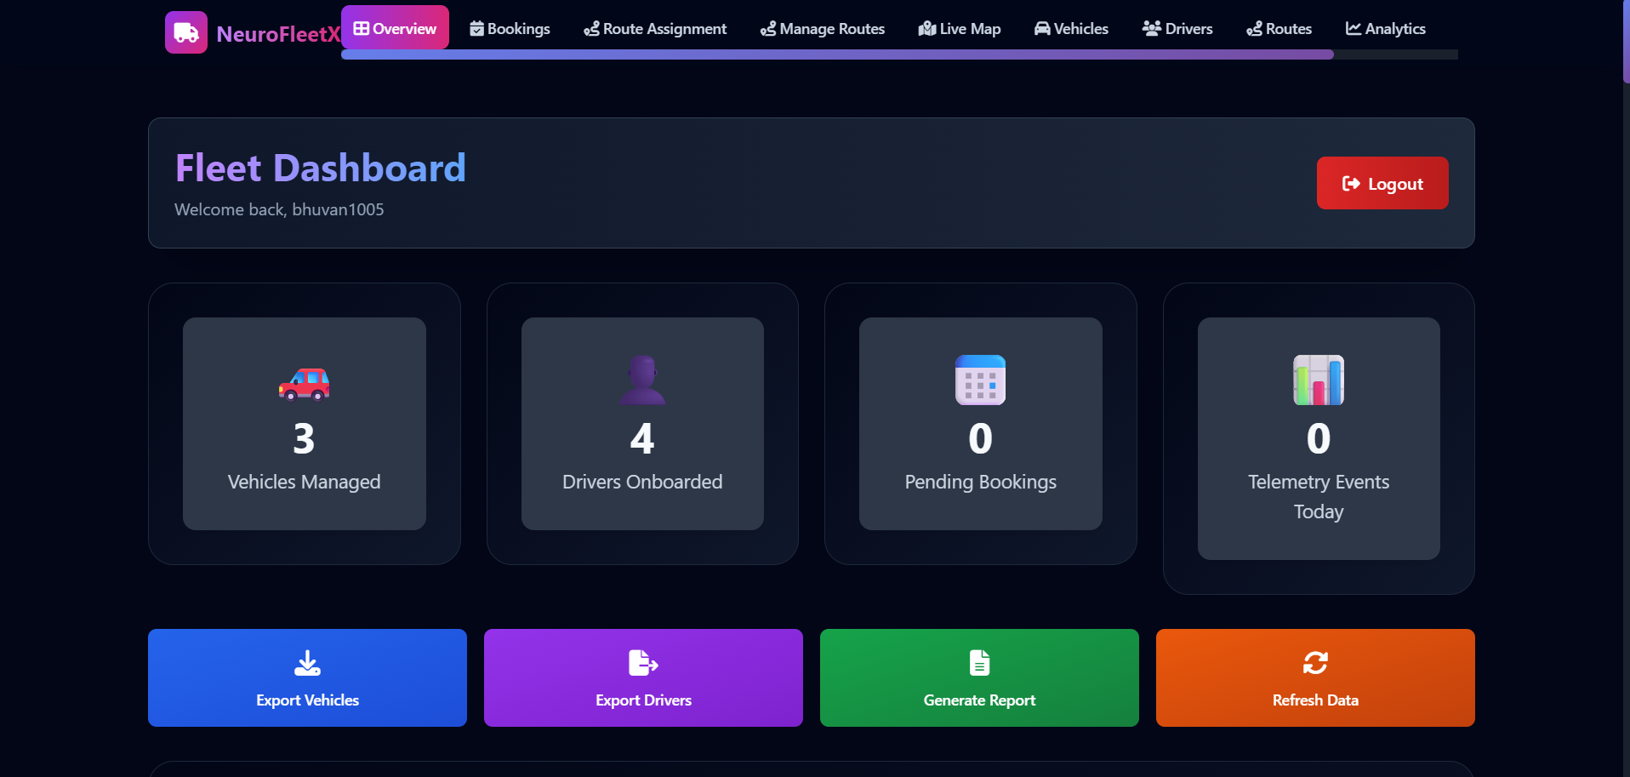
Project Output & Results - Screenshot 2

Slide 11
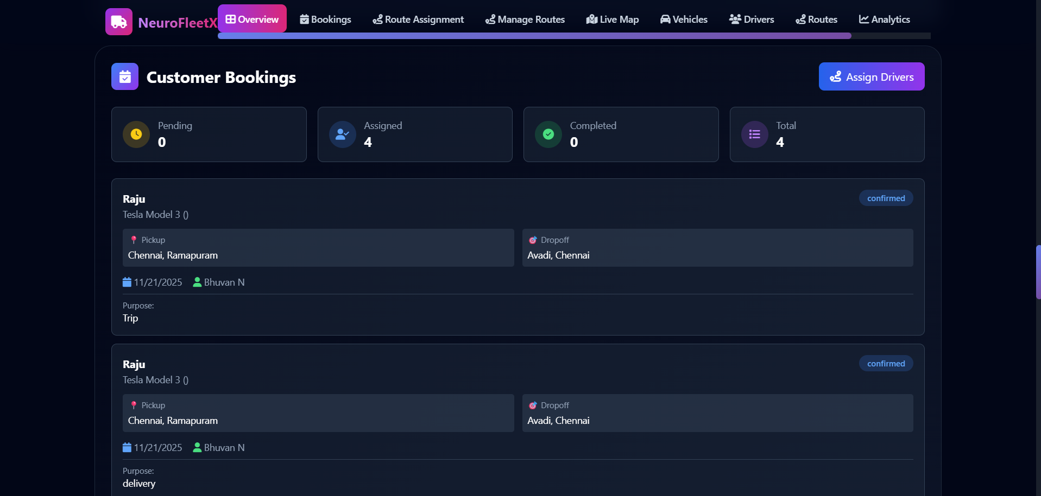
Project Output & Results - Screenshot 3

Slide 12
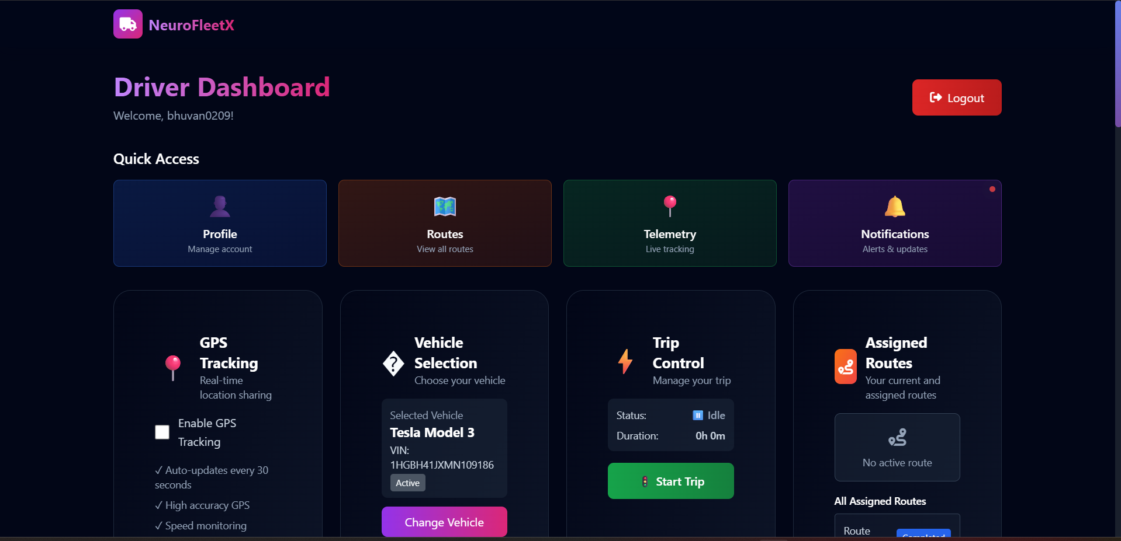
Project Output & Results - Screenshot 4

Slide 13
Conclusion & Acknowledgement
Conclusion
Acknowledgement
The NeuroFleetX project stands as a transformative internship experience, successfully demonstrating the practical application of AI in urban mobility optimization. Key achievements include the development of sophisticated predictive models for traffic management, a robust full-stack implementation utilizing React for the frontend, Spring Boot for powerful backend APIs, and MongoDB as a scalable database. The project's successful execution across two agile sprints further highlights effective project management. This experience has significantly refined my skills in AI model integration, full-stack development, and agile methodologies, providing a solid foundation for future endeavors.
I express my sincere gratitude to Infosys Springboard for providing this invaluable internship opportunity and fostering a truly collaborative learning environment. My heartfelt thanks go to the mentors for their expert guidance, continuous support, and constructive feedback throughout the project, which were instrumental to its success. This experience offered the unique chance to work on a real-world problem, significantly contributing to my professional development. I am confident that the knowledge and skills gained will profoundly shape my future career endeavors.

